Slide 1



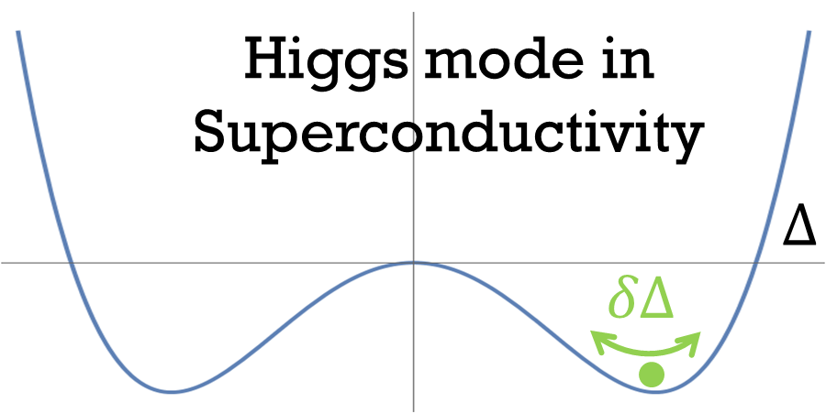
Nonequilibrium Corrections and Higgs Mode
in Superconducting Devices:
Unraveling the Pronounced Anti-Q Slope in High-Frequency regime
and Current-Dependent Kinetic Inductance
High energy Accelerator Research Organization (KEK)
Takayuki Kubo
This talk is based on the following 3 papers
T. Kubo, Phys. Rev. Applied 22, 044042 (2024) DOI: https://doi.org/10.1103/PhysRevApplied.22.044042
T. Kubo, Phys. Rev. Applied 23, 054091 (2025) DOI: https://doi.org/10.1103/PhysRevApplied.23.054091
T. Kubo, arXiv:2509.09766 DOI: https://doi.org/10.48550/arXiv.2509.09766
Sep.25
THA06

Slide 2
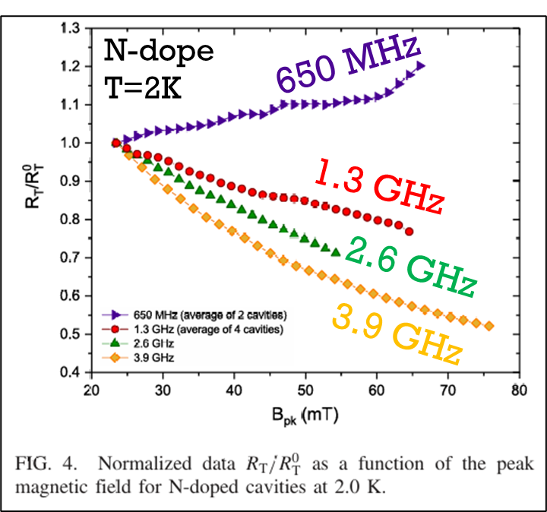

One of the main theoretical questions in SRF physics is how the $R_{s}(B)$ curve depends on frequency.
M. Martinello et al., Phys. Rev. Lett. 121, 224801 (2018)
DOI: https://doi.org/10.1103/PhysRevLett.121.224801

Slide 3
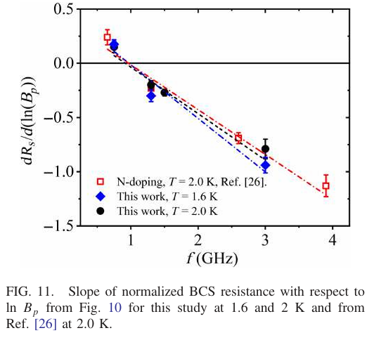
One of the main theoretical questions in SRF physics is how the $R_{s}(B)$ curve depends on frequency.
P. Dhakal, B. D. Khanal, A. Gurevich, and G. Ciovati, Phys. Rev. Accel. Beams 27, 062001 (2024) DOI: https://doi.org/10.1103/PhysRevAccelBeams.27.062001

Slide 4
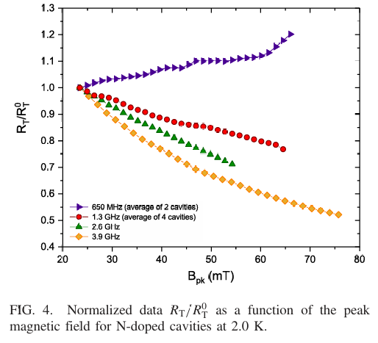

One of the main theoretical questions in SRF physics is how the $R_{s}(B)$ curve depends on frequency.
There is a threshold around 1 GHz: below it, the curve bends upward; above it, the curve bends downward — the so-called anti-Q slope.
N-dope
T=2K
650 MHz
1.3 GHz
2.6 GHz
3.9 GHz
P. Dhakal, B. D. Khanal, A. Gurevich, and G. Ciovati,
Phys. Rev. Accel. Beams 27, 062001 (2024) DOI: https://doi.org/10.1103/PhysRevAccelBeams.27.062001
M. Martinello et al., Phys. Rev. Lett. 121, 224801 (2018)
DOI: https://doi.org/10.1103/PhysRevLett.121.224801

Slide 5
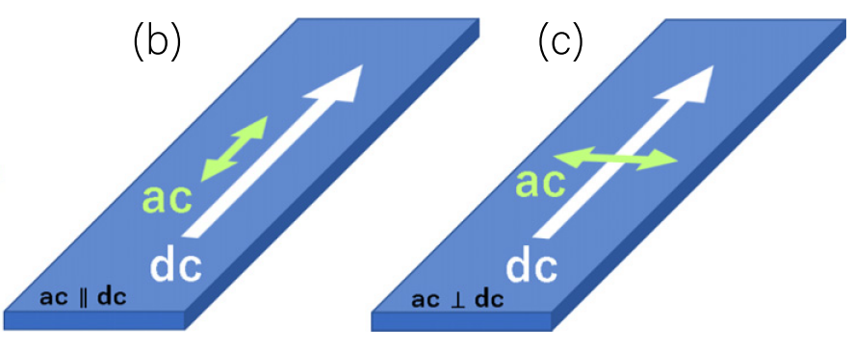
To address this problem, we consider
a superconductor carrying a DC current and perturbed by a weak AC field.
This approach provides a key clue to understanding the issue.
The detailed discussions are found here:
T. Kubo, Phys. Rev. Applied 22, 044042 (2024) DOI: https://doi.org/10.1103/PhysRevApplied.22.044042
T. Kubo, Phys. Rev. Applied 23, 054091 (2025) DOI: https://doi.org/10.1103/PhysRevApplied.23.054091

Slide 6
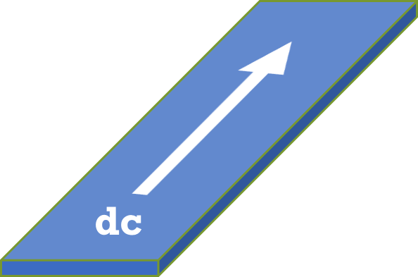
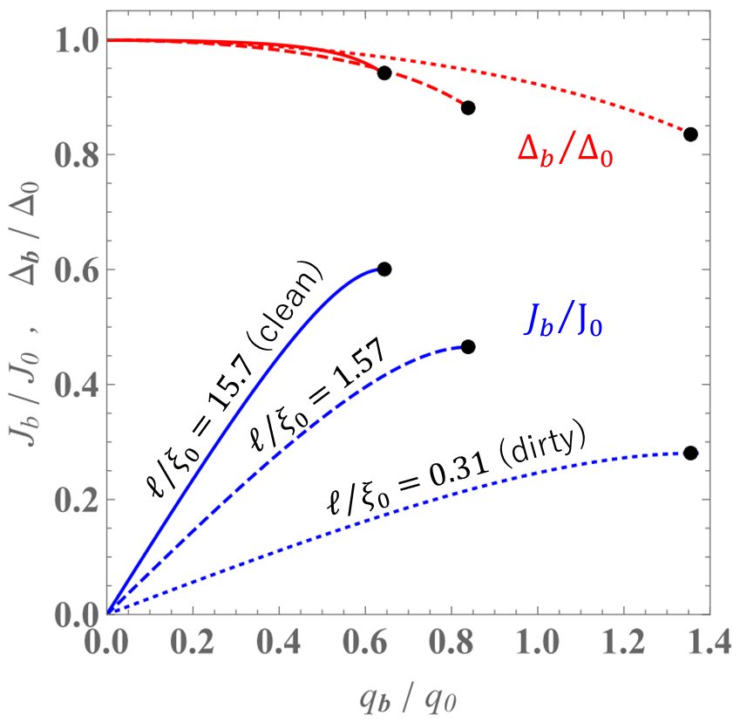
If the AC field is absent, this reduces to a problem of equilibrium superconductivity.
That case was already well understood decades ago.
T. Kubo, Phys. Rev. Applied 22, 044042 (2024) DOI: https://doi.org/10.1103/PhysRevApplied.22.044042
See also, T. Kubo, Phys. Rev. Research 2, 033203 (2020); F. Pei-Jen Lin and A. Gurevich, Phys. Rev. B 85, 054513 (2012)

Slide 7
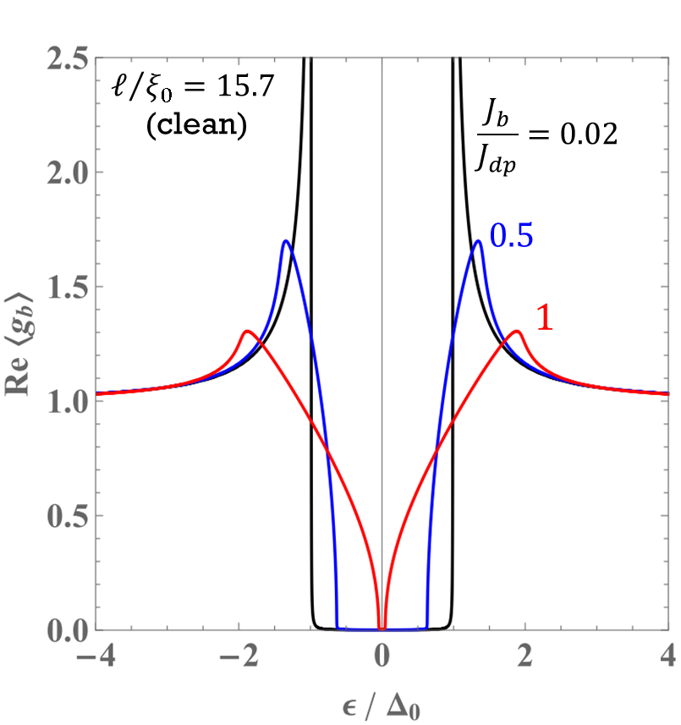
If the AC field is absent, this reduces to a problem of equilibrium superconductivity.
That case was already well understood decades ago.
T. Kubo, Phys. Rev. Applied 22, 044042 (2024) DOI: https://doi.org/10.1103/PhysRevApplied.22.044042
See also, T. Kubo, Phys. Rev. Research 2, 033203 (2020); F. Pei-Jen Lin and A. Gurevich, Phys. Rev. B 85, 054513 (2012)

Slide 8
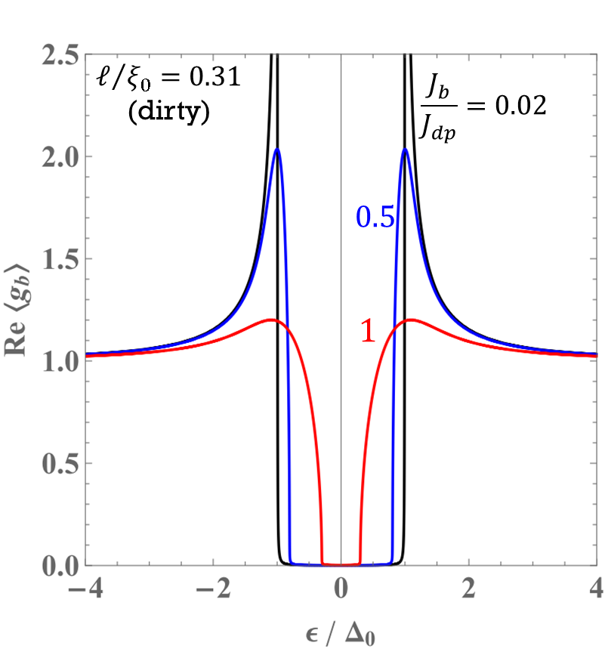
If the AC field is absent, this reduces to a problem of equilibrium superconductivity.
That case was already well understood decades ago.
T. Kubo, Phys. Rev. Applied 22, 044042 (2024) DOI: https://doi.org/10.1103/PhysRevApplied.22.044042
See also, T. Kubo, Phys. Rev. Research 2, 033203 (2020); F. Pei-Jen Lin and A. Gurevich, Phys. Rev. B 85, 054513 (2012)

Slide 9

However, once an AC field is present, the problem becomes much more complicated. In that case, we need to use the theory of nonequilibrium superconductivity.
A. Moor et al., Phys. Rev. Lett. 118, 047001 (2017)
T. Jujo, J. Phys. Soc. Jpn. 91, 074711 (2022)
T. Kubo, Phys. Rev. Applied 22, 044042 (2024)
T. Kubo, Phys. Rev. Applied 23, 054091 (2025)
The Keldysh-Eilenberger theory is a microscopic theory of nonequilibrium superconductivity. It is applicable at any temperature ($0≤T≤T_{c}$) and for arbitrary mean free path. In this sense, it serves as the “theory of everything for conventional superconductivity”.
The Keldysh–Usadel theory represents the dirty-limit reduction of the Keldysh–Eilenberger theory of nonequilibrium superconductivity, applicable at any T ($0≤T≤T_{c}$).
T. Kubo, Phys. Rev. Applied 22, 044042 (2024)
T. Kubo, Phys. Rev. Applied 23, 054091 (2025)

Slide 10
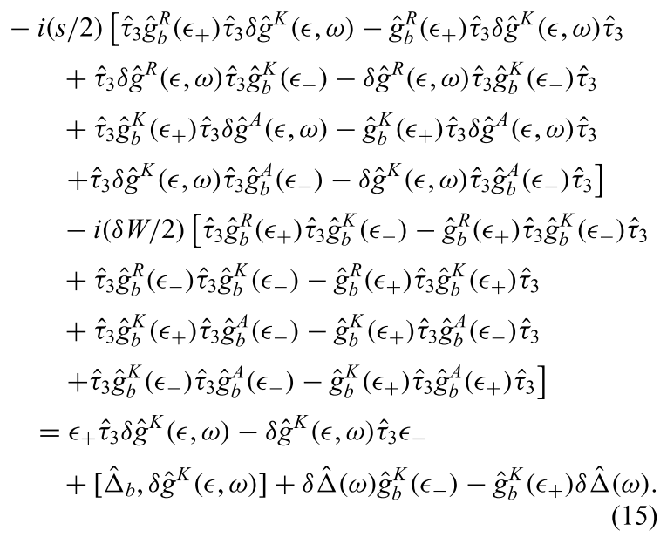
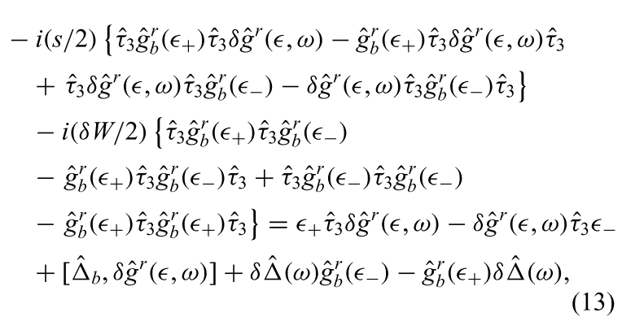
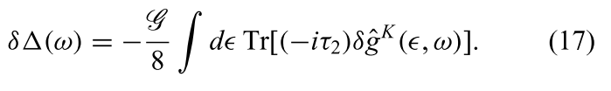
Keldysh–Usadel Equation: DC Current with AC Perturbation
T. Kubo, Phys. Rev. Applied 23, 054091 (2025)
Higgs
↓
We solve these equations to obtain the AC-induced nonequilibrium corrections ($δ{\hat{g}}^{R, A, K}$ and $δΔ$).

Slide 11
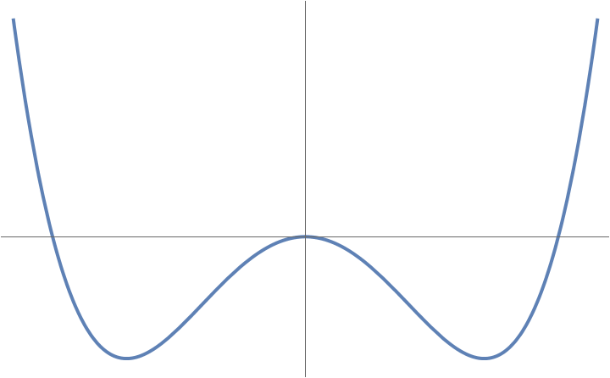
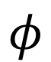

Keldysh–Usadel Equation: DC Current with AC Perturbation
T. Kubo, Phys. Rev. Applied 23, 054091 (2025)
Higgs
↓
We solve these equations to obtain the AC-induced nonequilibrium corrections ($δ{\hat{g}}^{R, A, K}$ and $δΔ$).
Higgs?
Particle physics
$$φ$$
$$h$$

Slide 12
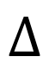
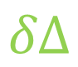
Keldysh–Usadel Equation: DC Current with AC Perturbation
T. Kubo, Phys. Rev. Applied 23, 054091 (2025)
Higgs
↓
We solve these equations to obtain the AC-induced nonequilibrium corrections ($δ{\hat{g}}^{R, A, K}$ and $δΔ$).
Higgs?
Particle physics
Superconductivity
Oscillation of
superfluid density
$$φ$$
$$Δ$$
$$h$$
$$δΔ$$

Slide 13
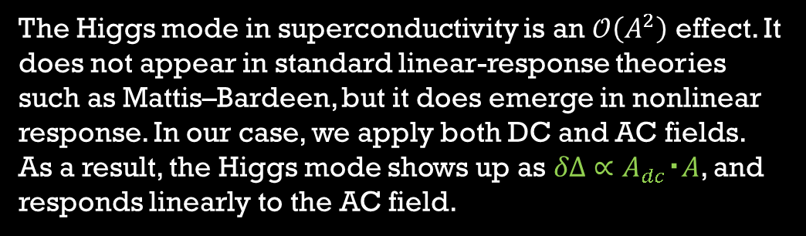
Keldysh–Usadel Equation: DC Current with AC Perturbation
T. Kubo, Phys. Rev. Applied 23, 054091 (2025)
Higgs
↓
We solve these equations to obtain the AC-induced nonequilibrium corrections ($δ{\hat{g}}^{R, A, K}$ and $δΔ$).
Higgs?
See the famous review paper:
R. Shimano and N. Tsuji,
Annu. Rev. Condens. Matter Phys. 11, 103 (2020)
Superconductivity
The Higgs mode in superconductivity is an $𝒪\left(A^{2}\right)$ effect. It does not appear in standard linear-response theories such as Mattis–Bardeen, but it does emerge in nonlinear response. In our case, we apply both DC and AC fields. As a result, the Higgs mode shows up as $δΔ∝A_{dc}・A$, and responds linearly to the AC field.
Oscillation of
superfluid density
$$Δ$$
$$δΔ$$

Slide 14
Keldysh–Usadel Equation: DC Current with AC Perturbation
T. Kubo, Phys. Rev. Applied 23, 054091 (2025)
Higgs
↓
We solve these equations to obtain the AC-induced nonequilibrium corrections ($δ{\hat{g}}^{R, A, K}$ and $δΔ$).

Slide 15
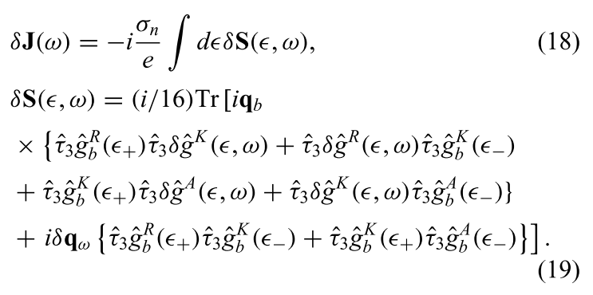

Keldysh–Usadel Equation: DC Current with AC Perturbation
T. Kubo, Phys. Rev. Applied 23, 054091 (2025)
Higgs
↓
We solve these equations to obtain the AC-induced nonequilibrium corrections ($δ{\hat{g}}^{R, A, K}$ and $δΔ$).
To obtain the ac response,
we substitute the solutions ($δ{\hat{g}}^{R, A, K}$, $δΔ$) into

Slide 16

Instead of showing the rigorous algebraic calculations, we will look at schematic illustrations that represent the final results.
$$J∼Agg+A_{dc}gδg$$

Slide 17


Instead of showing the rigorous algebraic calculations, we will look at schematic illustrations that represent the final results.
$$J∼Agg+A_{dc}gδg$$
$$A$$

Slide 18

Instead of showing the rigorous algebraic calculations, we will look at schematic illustrations that represent the final results.
$$J∼Agg+A_{dc}gδg$$
$δg∼A_{dc}∙A+δΔ$ and $δΔ∼Ψ$ $A_{dc}∙A$
$$A$$

Slide 19








Instead of showing the rigorous algebraic calculations, we will look at schematic illustrations that represent the final results.
$$J∼Agg+A_{dc}gδg$$
$δg∼A_{dc}∙A+δΔ$ and $δΔ∼Ψ$ $A_{dc}∙A$
$$A_{dc}$$
$$A_{dc}$$
$$A_{dc}$$
$$+$$
$$A_{dc}$$
$$A$$
$$Ψ$$
$$A$$
Higgs mediated contribution
$$A$$
AAA cotribution

Slide 20



Instead of showing the rigorous algebraic calculations, we will look at schematic illustrations that represent the final results.
$$J∼Agg+A_{dc}gδg$$
$δg∼A_{dc}∙A+δΔ$ and $δΔ∼Ψ$ $A_{dc}∙A$
$$A_{dc}$$
$$A_{dc}$$
$$A_{dc}$$
$$+$$
$$A_{dc}$$
$$A$$
$$Ψ$$
$$A$$
Higgs mediated contribution
$$A$$
AAA cotribution
$$∝A_{dc}∙A$$
$$∝A_{dc}∙A$$
Nonequilibrium corrections due to the Doppler fluctuation of flow $∝A_{dc}∙A$

Slide 21

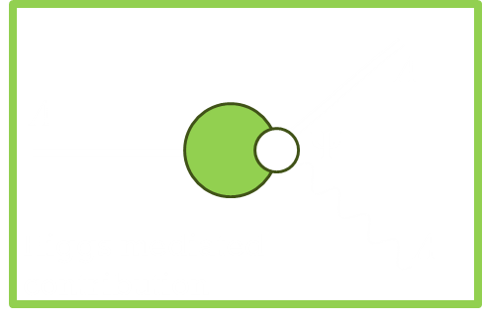


Instead of showing the rigorous algebraic calculations, we will look at schematic illustrations that represent the final results.
$$J∼Agg+A_{dc}gδg$$
$δg∼A_{dc}∙A+δΔ$ and $δΔ∼Ψ$ $A_{dc}∙A$
$$A_{dc}$$
$$A_{dc}$$
$$A_{dc}$$
$$+$$
$$A_{dc}$$
$$A$$
$$Ψ$$
$$A$$
Higgs mediated contribution
$$A$$
AAA cotribution
Then, the complex conductivity is given by
$$σ=\frac{J}{E}∼\frac{ + + }{A}$$

Slide 22
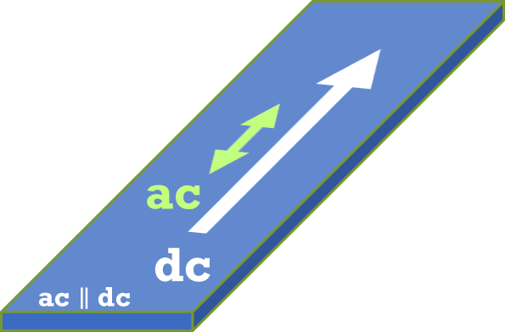
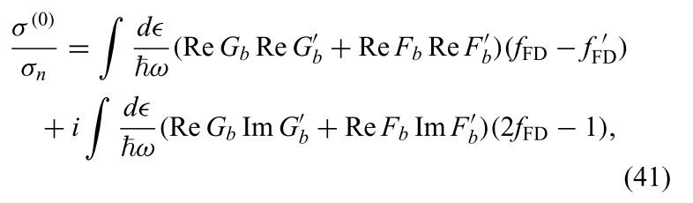

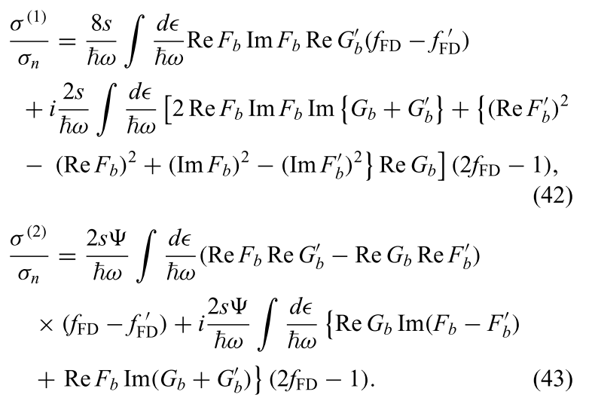






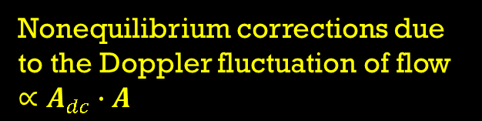
Complex conductivity formula
T. Kubo, Phys. Rev. Applied 23, 054091 (2025)
$ac∥dc$ case
$$σ=σ^{(0)}+σ^{(1)}+σ^{(2)}$$
AAA
contribution
$$∝A_{dc}∙A$$
Higgs
mediated contribution
Nonequilibrium corrections due to the Doppler fluctuation of flow $∝A_{dc}∙A$
$$∝A_{dc}∙A$$

Slide 23
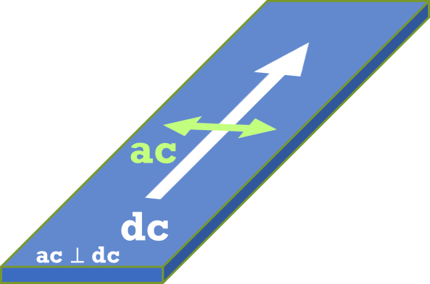



Complex conductivity formula
T. Kubo, Phys. Rev. Applied 23, 054091 (2025)
$ac∥dc$ case
$ac⊥dc$ case
$$σ=σ^{(0)}+σ^{(1)}+σ^{(2)}$$
$$σ=σ^{(0)}$$
$$∼$$
AAA
contribution
No Doppler fluctuation
$$∝A_{dc}∙A$$
Higgs
mediated contribution
Nonequilibrium corrections due to the Doppler fluctuation of flow $∝A_{dc}∙A$
$$∝A_{dc}∙A$$

Slide 24
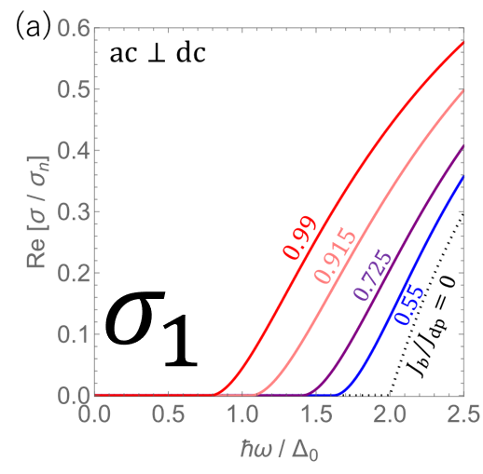
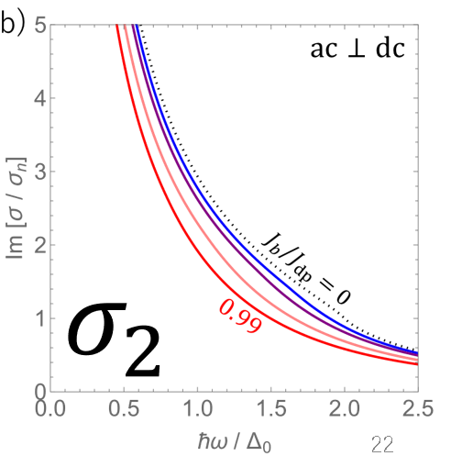

ac $⊥$ dc
T. Kubo,
Phys. Rev. Applied 23, 054091 (2025)

Slide 25
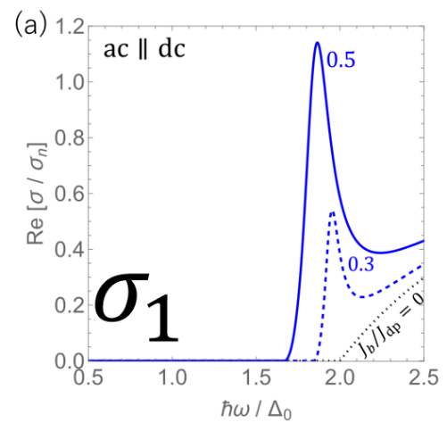
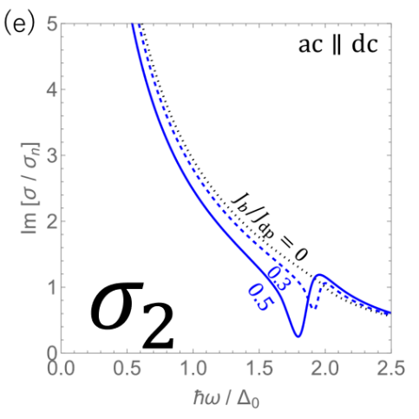

ac $∥$ dc
ac $⊥$ dc
Resonance peak due to the Higgs mode.
Already observed in experiments!
S. Nakamura et al.,
PRL 122, 257001 (2019)
T. Kubo,
Phys. Rev. Applied 23, 054091 (2025)
T. Kubo,
Phys. Rev. Applied 23, 054091 (2025)

Slide 26





The contributions from the nonequilibrium corrections are significant even at low frequencies
$$σ=σ^{(0)}+σ^{(1)}+σ^{(2)}$$
Direct AAA photon action
Higgs mediated contribution
Significantly contributes to
$Re[σ]$ , $Im[σ]$
even at low frequencies $(ℏω≪Δ)$
Significantly contributes to
$$Im[σ]$$
even at low frequencies $(ℏω≪Δ)$

Slide 27
The contributions from the nonequilibrium corrections are significant even at low frequencies
$$σ=σ^{(0)}+σ^{(1)}+σ^{(2)}$$
Direct AAA photon action
Higgs mediated contribution
Significantly contributes to
$Re[σ]$ , $Im[σ]$
even at low frequencies $(ℏω≪Δ)$
Significantly contributes to
$$Im[σ]$$
even at low frequencies $(ℏω≪Δ)$
Surface resistance
or
quality factor

Slide 28
The contributions from the nonequilibrium corrections are significant even at low frequencies
$$σ=σ^{(0)}+σ^{(1)}+σ^{(2)}$$
Direct AAA photon action
Higgs mediated contribution
Significantly contributes to
$Re[σ]$ , $Im[σ]$
even at low frequencies $(ℏω≪Δ)$
Significantly contributes to
$$Im[σ]$$
even at low frequencies $(ℏω≪Δ)$
Surface resistance
or
quality factor
Kinetic inductance

Slide 29





Biproduct: the theory of current-dependent kinetic inductance is now established.
$$L_{k}\left(J\right)=L_{k}(0)\left\{1+C{\left(\frac{J}{J_{dp}}\right)}^{2}+…\right\}$$
$ac∥dc$ case
For $\left(T, ω\right)→(0, 0)$, we can analytically calculate the coefficient C:
AAA
Higgs
$$C=C^{(0)}+C^{(1)}+C^{(2)}≃0.409$$
$$≃0.136$$
$$≃0.0956$$
$$≃0.177$$
(23%)
(43%)
T. Kubo, Phys. Rev. Applied 22, 044042 (2024)
T. Kubo, Phys. Rev. Applied 23, 054091 (2025)
43% comes from Higgs!

Slide 30
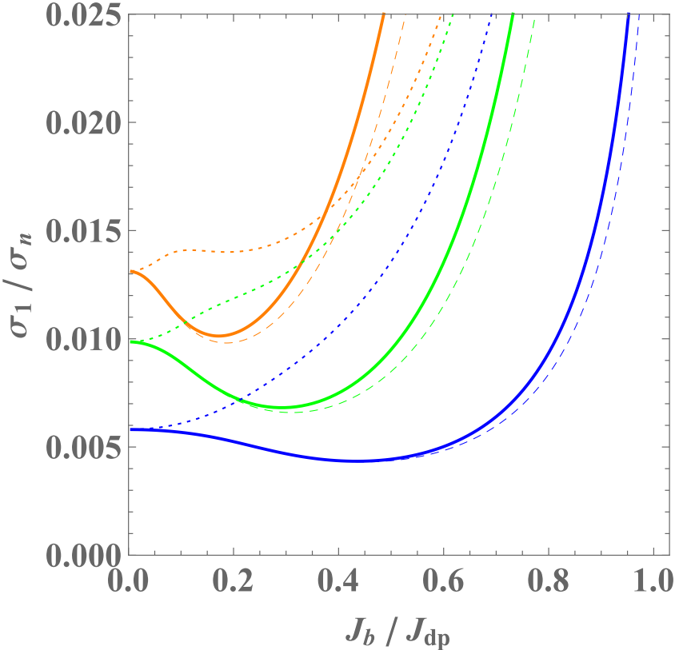
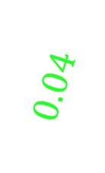
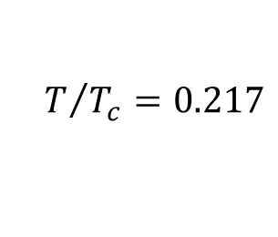
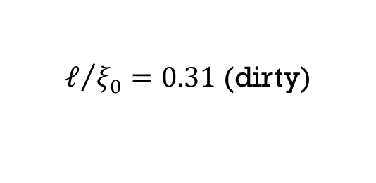
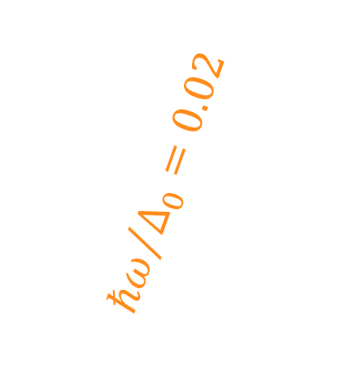
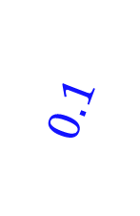
Analogue R_{s}(E) curve
in ac+dc system
$${ℏω}/{Δ_{0}}=0.02$$
$$0.04$$
$$0.1$$
dc: arbitrary strength
ac: perturbation
$ℓ/{ξ_{0}}=0.31$ (dirty)
$$T/{T_{c}}=0.217$$
T. Kubo, Phys. Rev. Applied 22, 044042 (2024)

Slide 31

Let’s see the orange curves (${ℏω}/{Δ_{0}}=0.02$),which correspond to 7GHz for Nb.
7GHz for Nb
$${ℏω}/{Δ_{0}}=0.02$$
$$0.04$$
$$0.1$$
$ℓ/{ξ_{0}}=0.31$ (dirty)
$$T/{T_{c}}=0.217$$
T. Kubo, Phys. Rev. Applied 22, 044042 (2024)

Slide 32

Let’s see the orange curves (${ℏω}/{Δ_{0}}=0.02$),which correspond to 7GHz for Nb.
$${ℏω}/{Δ_{0}}=0.02$$
Dotted curve:
$$Re[σ^{\left(0\right)}]$$
$$0.04$$
$$0.1$$
$ℓ/{ξ_{0}}=0.31$ (dirty)
$$T/{T_{c}}=0.217$$
T. Kubo, Phys. Rev. Applied 22, 044042 (2024)

Slide 33
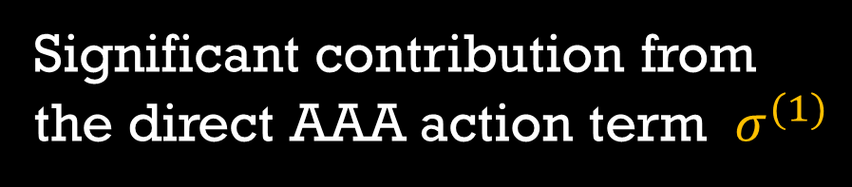
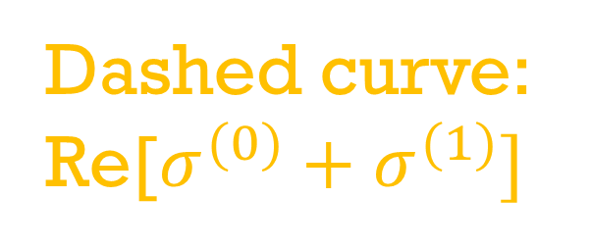
Let’s see the orange curves (${ℏω}/{Δ_{0}}=0.02$),which correspond to 7GHz for Nb.
$${ℏω}/{Δ_{0}}=0.02$$
Dotted curve:
$$Re[σ^{\left(0\right)}]$$
$$0.04$$
$$0.1$$
Dashed curve:
Re[$σ^{(0)}+σ^{(1)}]$
$ℓ/{ξ_{0}}=0.31$ (dirty)
$$T/{T_{c}}=0.217$$
Significant contribution from
the direct AAA action term $σ^{(1)}$
T. Kubo, Phys. Rev. Applied 22, 044042 (2024)

Slide 34
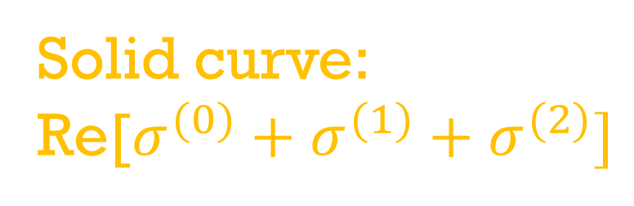
Let’s see the orange curves (${ℏω}/{Δ_{0}}=0.02$),which correspond to 7GHz for Nb.
$${ℏω}/{Δ_{0}}=0.02$$
Dotted curve:
$$Re[σ^{\left(0\right)}]$$
$$0.04$$
$$0.1$$
Dashed curve:
Re[$σ^{(0)}+σ^{(1)}]$
Solid curve:
Re[$σ^{(0)}+σ^{(1)}+σ^{(2)}]$
$ℓ/{ξ_{0}}=0.31$ (dirty)
$$T/{T_{c}}=0.217$$
Significant contribution from
the direct AAA action term $σ^{(1)}$
T. Kubo, Phys. Rev. Applied 22, 044042 (2024)

Slide 35
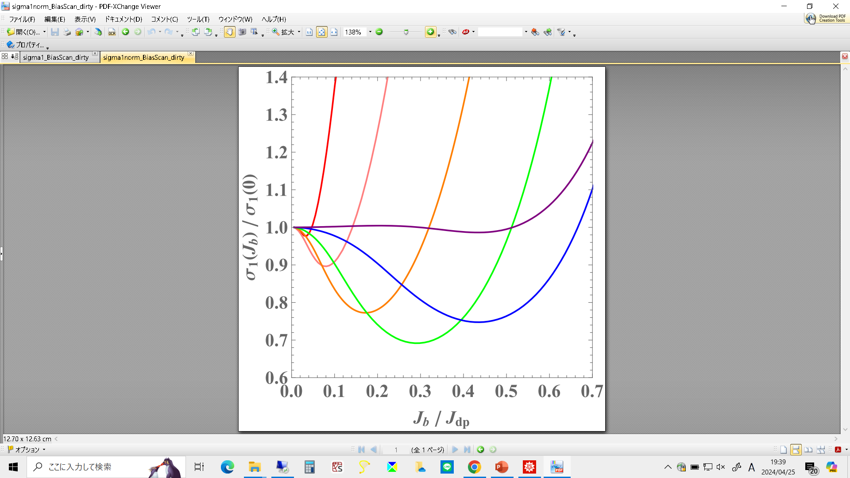
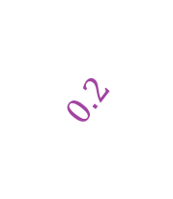
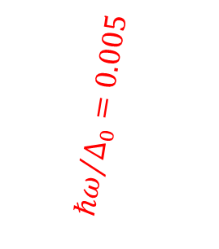
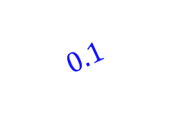

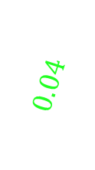
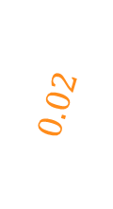
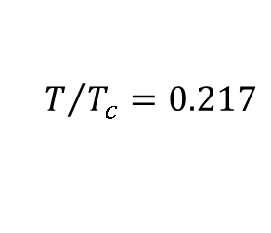
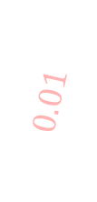
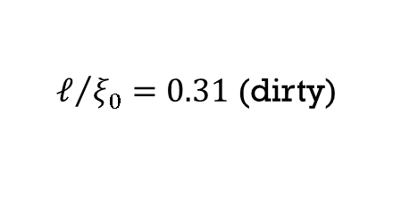
The analogue anti Q-slope is pronounced as the frequency increases
1.8 GHz for Nb
3.6 GHz for Nb
14 GHz for Nb
$${ℏω}/{Δ_{0}}=0.005$$
$$0.2$$
$$0.01$$
7 GHz for Nb
$$0.02$$
$$0.04$$
The key player is the direct AAA photon action
36 GHz for Nb
$$0.1$$
$$σ=σ^{(0)}+σ^{(1)}+σ^{(2)}$$
$ℓ/{ξ_{0}}=0.31$ (dirty)
$$T/{T_{c}}=0.217$$
Big clue to understand the pronounced anti Q-slope with increasing frequency
T. Kubo, Phys. Rev. Applied 22, 044042 (2024)

Slide 37
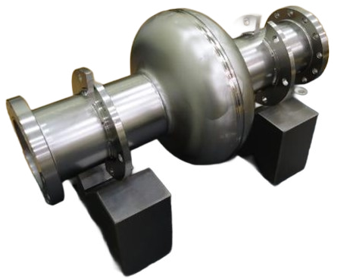
Nonequilibrium
Nonlinear Response theory of
amplitude dependent conductivity
under strong ac field
The detailed discussions are found here:
T. Kubo, arXiv:2509.09766 DOI: https://doi.org/10.48550/arXiv.2509.09766

Slide 38
We do not consider any dc bias.
We consider a superconductor under a strong ac field

Slide 39
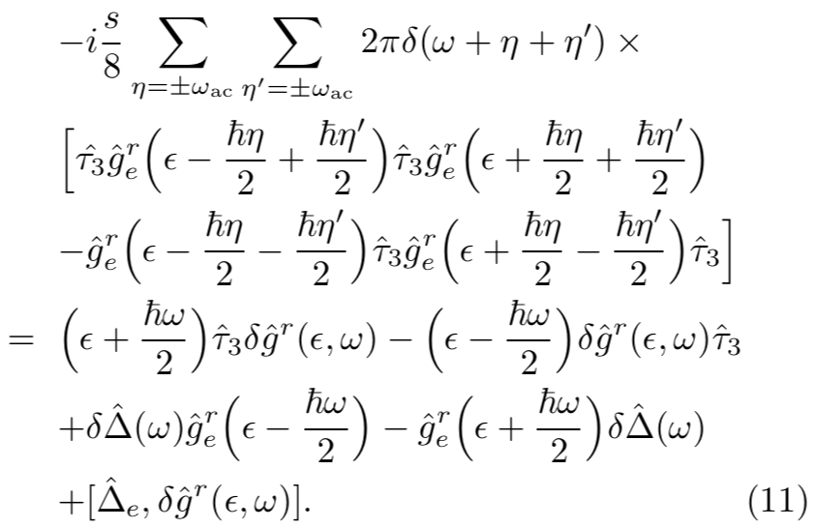
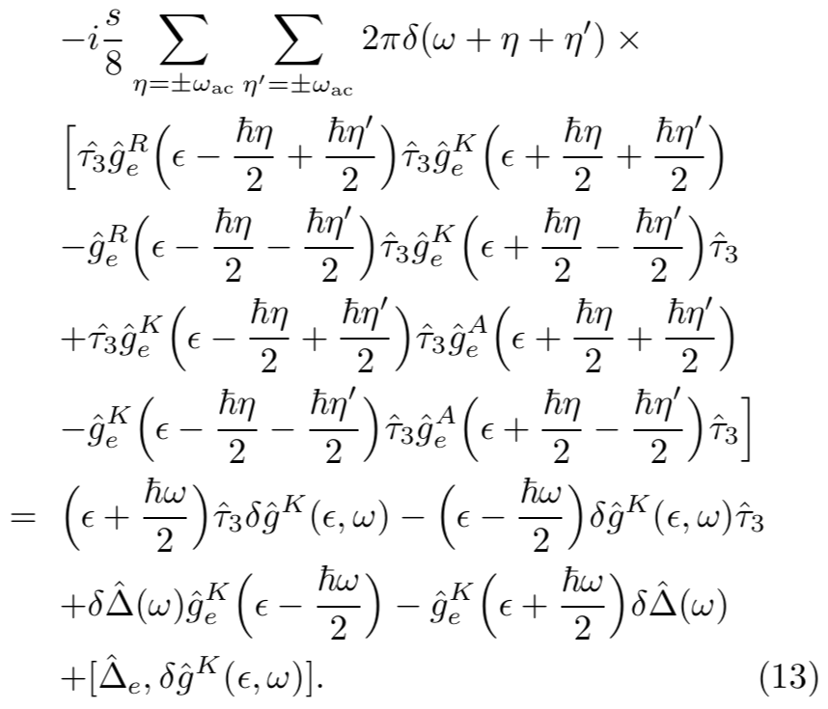
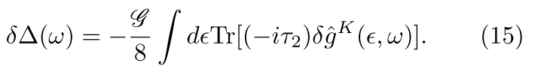




Keldysh–Usadel Equation for SC under a strong ac field
arXiv:2509.09766
Much different
from the ac+dc case
We solve these equations to obtain the nonequilibrium corrections ($δ{\hat{g}}^{R, A, K}$ and $δΔ$).
To obtain the current response,
we substitute the solutions ($δ{\hat{g}}^{R, A, K}$, $δΔ$) into
← Linear response
← Nonlinear correction of $𝒪(A^{3})$

Slide 40












Schematically, the results can be illustrated as
$$J∼Agg+Agδg$$
$δg∼A^{2}+δΔ$ and $δΔ∼Ψ$ $A^{2}$
Linear
response
Nonlinear corrections
$$+$$
$$≃$$
$$J_{ac+dc }∼$$
$$+$$
$$+$$

Slide 41


Schematically, the results can be illustrated as
$$J∼Agg+Agδg$$
$δg∼A^{2}+δΔ$ and $δΔ∼Ψ$ $A^{2}$
Linear
response
Nonlinear corrections
$$+$$
Note: This theory automatically includes
the Eliashberg effect (microwave-induced gap enhancement) as well as the Higgs-mode contribution.
Time averaged $δΔ$:
Eliashberg effect
Time dependent $δΔ$:
Higgs

Slide 42


Eliashberg effect
Higgs mode
arXiv:2509.09766
arXiv:2509.09766
See also,
M. Silaev, Phys. Rev. B 99, 224511 (2019) P. Derendorf, A. F. Volkov, and I. M. Eremin, Phys. Rev. B 109, 024510 (2024)

Slide 43








Nonlinear correction
arXiv:2509.09766
Higgs
Contribution:
Time dependent $δΔ$
Eliashberg
Contribution:
Time averaged $δΔ$

Slide 44

Results

Slide 45
Results
The resonance peak at Δ
comes from the Higgs mode

Slide 46

Results
The resonance peak at Δ
comes from the Higgs mode
At lower frequencies,
$σ_{1}+δσ_{1}$ is a decreasing function of the ac amplitude (q).

Slide 47

Results
The resonance peak at Δ
comes from the Higgs mode
At lower frequencies,
$σ_{1}+δσ_{1}$ is a decreasing function of the ac amplitude (q).
The AAA term is
the dominant contributor
at low frequencies

Slide 48



ac amplitude dependent dissipative conductivity
Dirty limit ($ℓ≪ξ_{0}$)
360MHz for Nb
720MHz for Nb
$$Γ/{Δ_{0}={10}^{−3}}$$
1.8GHz for Nb
3.6GHz for Nb
arXiv:2509.09766
Note: this corresponds to a few (mT)

Slide 49

ac amplitude dependent dissipative conductivity
Dirty limit ($ℓ≪ξ_{0}$)
360MHz for Nb
Experiments:
Moderately dirty ($ℓ∼ξ_{0}$)
720MHz for Nb
$$Γ/{Δ_{0}={10}^{−3}}$$
1.8GHz for Nb
3.6GHz for Nb
arXiv:2509.09766
M. Martinello et al., Phys. Rev. Lett. 121, 224801 (2018)
DOI: https://doi.org/10.1103/PhysRevLett.121.224801
Note: this corresponds to a few (mT)

Slide 50
ac amplitude dependent dissipative conductivity
To deal with the red-framed region, the theory must be extended nonperturbatively to capture the quasiparticle spectrum modified by strong AC currents.
Experiments:
Moderately dirty ($ℓ∼ξ_{0}$)
T. Kubo, arXiv:2509.09766 (2025)
Nonperturbative extension like the previous studies:
A. Gurevich, Phys. Rev. Lett. 113, 087001 (2014)
T. Kubo and A. Gurevich, Phys. Rev. B 100, 064522 (2019)
M. Martinello et al., Phys. Rev. Lett. 121, 224801 (2018)
DOI: https://doi.org/10.1103/PhysRevLett.121.224801
The theory of SRF

Slide 51
Summary
AAA term
The frequency dependent anti-Q slope can be explained by the nonlinear AAA term. The Eliashberg effect and the Higgs mode contributions are not significant in SRF regime.
We are only one step away from establishing the SRF theory. A nonperturbative extension of the present theory will complete it.
Eliashberg and Higgs
→ Nonequilibrium Nonlinear Nonperturbative ac response theory

Slide 52

Acknowledgement
This work was conducted independently, and I take full responsibility for its content.
Nevertheless, its foundation stems from my visit to Alex Gurevich at Old Dominion University in 2016 and from my sabbatical there between 2017 and 2019.
Oct. 2016
Norfolk
I deeply appreciate his warm hospitality and invaluable support during those stays.

Slide 54





Effects of the inelastic scattering (e.g., electron-phonon) rate
$$Γ/{Δ_{0}=0.001}$$
$$Γ/{Δ_{0}=}0.01$$
Dirty limit ($ℓ≪ξ_{0}$)
360MHz for Nb
360MHz for Nb
3.6GHz for Nb
720MHz for Nb
1.8GHz for Nb
7.2GHz for Nb
$$Γ/{Δ_{0}={10}^{−3}}$$
3.6GHz for Nb
36GHz for Nb
arXiv:2509.09766
appendix
arXiv:2509.09766

